Slide 1


Workers & Server Events
Server Sent Event & WebSocket

Slide 2

Workers & Server Events
Course objectives
By completing this course, you will be able to:
Develop workers
Explain the different ways to manage server events
Use Server Sent Event
Explain what are the advantages of WebSockets
Use WebSockets

Slide 3


Server Events
Course topics
Course’s plan:
Workers
SE Introduction
Server Sent Event
WebSocket
Socket IO

Slide 4

Web worker
Workers & Server Events

Slide 5

Web Worker
Presentation
Web Workers API allows you to run scripts in the background
Independently of any user interface scripts !
Useful for long-running scripts
Don’t need to manage yielding to keep the page responsive

Slide 6
Web Worker
Thread safety
Web Workers use real OS-level threads
As in other technologies, bad concurrency code can cause starvations, dead locks and other side effects

Slide 7
Web Worker
Thread safety
To limit these issues, the API provides :
A carefully controlled communication between threads
No access to non-thread safe components or the DOM

Slide 8
Web Worker
Worker interface
The core of the API is the Worker interface
It provides the following constructor :
Worker(scriptUrl) :
Creates a web worker that executes the script at the specified URL

Slide 9
Web Worker
Worker interface
It also provides the following methods :
postMessage(message) :
Sends a message to the worker's inner scope
terminate() :
Immediately terminates the worker without offers the worker an opportunity to finish its operations

Slide 10
Web Worker
Worker interface
And the following properties :
onmessage :
An event listener called when the worker return a message
onerror :
An event listener called when the worker return an error

Slide 11
Web Worker
Worker scope
Scripts executed by Workers have access to :
postMessage(message) function
Returns a message to the message handler of the main thread
onmessage property
Function which will receive messages sent when the worker object's postMessage() is called

Slide 12

Web Worker
Worker principle
Main thread
var worker = new Worker("worker.js");
worker.postMessage(message);
// Do something
worker.onmessage = function(event) {
// Do something
};
worker.js
...
onmessage = function(event) {
// Do something else
postMessage(message);
}

Slide 13
<ul id="result"></ul>
<script type="text/javascript">
var worker = new Worker('factorial.js');
worker.onmessage = function(event) {
var result = event.data;
var li = "<li>Factorial(" + result.n + "): ";
li += result.factorial + "</li>";
document.getElementById("result").innerHTML = li;
};
worker.postMessage(prompt("Number: "));
</script>
Example - index.html

Slide 14
function factorial(n, callback) {
if ((n == 0) || (n == 1)) callback(1);
else {
factorial(n - 1, function(result) {
postMessage({ n: (n - 1), factorial: result });
result *= n;
setTimeout(function() { callback(result) }, 2000);
});
}
}
self.onmessage = function(event) {
factorial(event.data, function(result) {
postMessage({ n: event.data, factorial: result });
});
}
Example - factoral.js

Slide 15
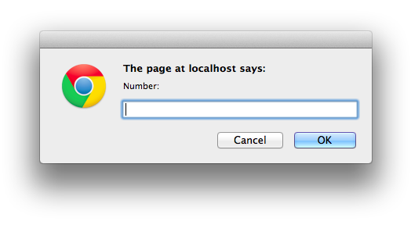
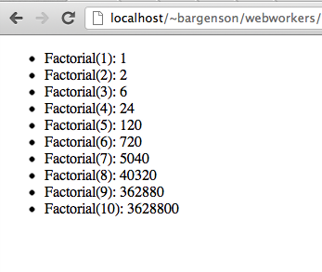
Web Worker
Example

Slide 16


Questions ?

Slide 17

Web Worker
Exercise (1/3)
During this exercise, we will develop a simple page which will
Fetch data from Node server every 30 seconds
Display them
The script fetching data must be execute by a WebWorker

Slide 18
Web Worker
Exercise (2/3)
Develop a simple NodeJS endpoint
Accessible at /workerData
Create a JSON structure with these properties:
id
timestamp
Add a record in this array each three seconds
Id must be incremented
Timestamp is the current timestamp

Slide 19
Web Worker
Exercise (3/3)
Your client script must check every 5 seconds if new data is available
If there are, you must send them to the UI thread to display them

Slide 20
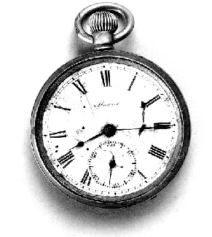
SE - Introduction
Workers & Server Events

Slide 21
SE - Introduction
Presentation
Normally when a browser visits a web page
An HTTP request is sent to the web server
The web server acknowledges this request and sends back the response
In many cases, the response could be stale by the time the browser renders the page…

Slide 22
SE - Introduction
Presentation
To get the most up-to-date "real-time" information without refreshing manually, you can use:
Polling
Long-polling
Streaming
And since recently, WebSockets !

Slide 23
SE - Introduction
Polling
Ajax client
Server
Update
request
response
request
response
Update
With polling, the browser sends HTTP requests at regular intervals and immediately receives a response

Slide 24
SE - Introduction
Long-Polling
Ajax client
Server
request
response
Update
request
response
Update
With long-polling, the browser sends a request to the server and the server keeps the request open for a set period

Slide 25
SE - Introduction
Streaming
Ajax client
Server
request
response
Update
response
Update
With streaming, the browser sends a complete request, but the server maintains an open response that is continuously updated

Slide 26
SE - Introduction
Benefits & Drawbacks
 | Benefits | Drawbacks
Polling | Good solution if the exact interval of message delivery is known | Many connections are opened and closed needlessly
Long-polling | Receive message updates immediately after they are delivered | Hold requests increases server load
Streaming | No need to send several requests | Hold requests and increases server load and browsers need to close and reconnect the channel to release memory
A common drawback of the three solutions, is that they use the HTTP protocol

Slide 27
Questions ?

Slide 28
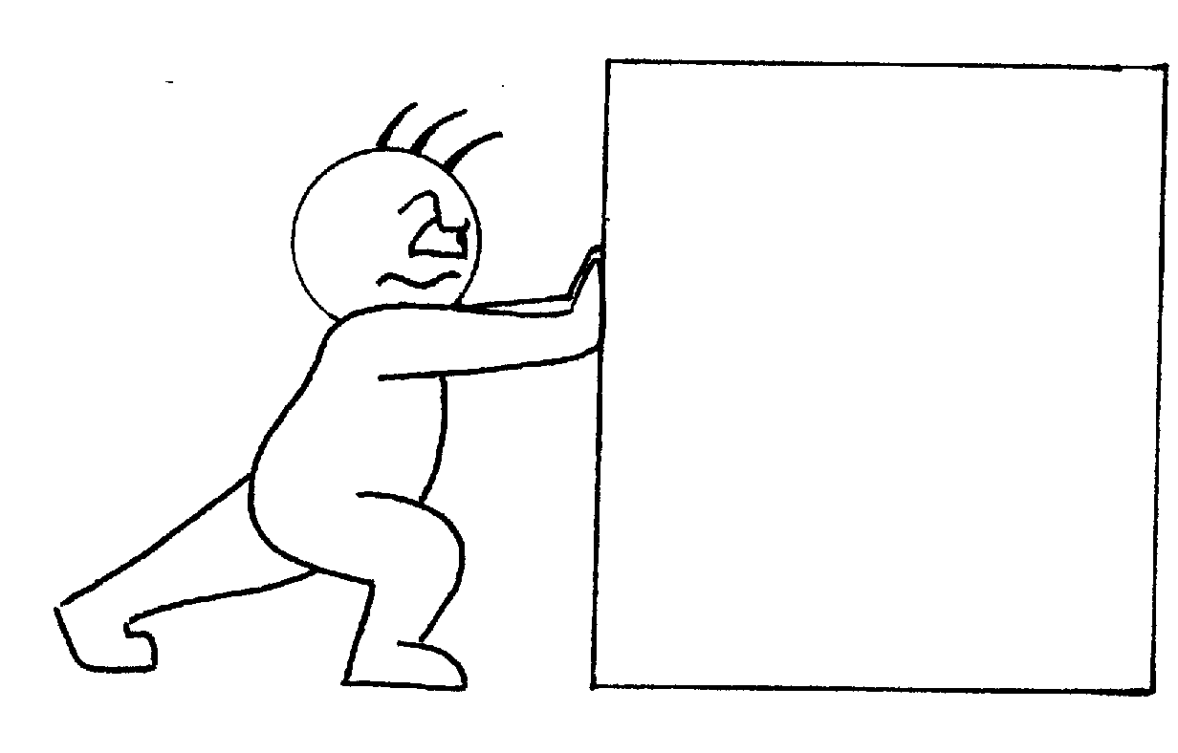
Server sent event
Server Events

Slide 29
Server Sent Event
Presentation
Server Sent Event (SSE) is a new specification for event streaming
Unidirectional channel
Use HTTP connection for receiving push notifications
Events in the form of DOM events

Slide 30

Server Sent Event
JavaScript API
SSE API provides the EventSource interface to open a connection to a stream
var source = new EventSource("/stream");
source.addEventListener("message", function(event) {
console.log(event.data);
});

Slide 31
Server Sent Event
JavaScript API
The constructor require an URL to a valid stream
Can be an absolute or relative URL
If absolute, its origin must match that of the calling page

Slide 32
Server Sent Event
JavaScript API
Once created, you can set up handlers for the following events :
open
messsage
error
source.addEventListener('message', function(e) { ... });
source.addEventListener('open', function(e) { ... });
source.addEventListener('error', function(e) { ... });

Slide 33
Server Sent Event
Event Stream Format
A SSE event stream must be :
A plaintext response
Served with a text/event-stream Content-Type
Each message must be
Prefixed by "data: "
Followed by two "\n" characters to end the sream
data: My message\n\n

Slide 34
Server Sent Event
Event Stream Format
You can send multiline message as follow :
Will produce "first line\nsecond line" in event.data
data: First line\n
data: Second line\n\n

Slide 35
Server Sent Event
Event Stream Format
You can also send JSON message as follow :
data: {\n
data: "msg": "hello world",\n
data: "id": 12345\n
data: }\n\n

Slide 36
Server Sent Event
Event ID
You can associate an event to a unique ID :
Lets the browser keep track of the last event fired
If the connection is dropped, a special HTTP header (Last-Event-ID) is set with the new request
id: 12345\n
data: Azerty\n\n

Slide 37
Server Sent Event
Event Name
You can associate an event to a name :
On the client, an event listener can be setup to listen to that particular event
event: userlogon\n
data: {"username": "John123"}\n\n
event: update\n
data: {"username": "John123", "emotion": "happy"}\n\n
source.addEventListener('userlogon', function(e) { ... });

Slide 38
Server Sent Event
SSE server
SSEs are sent over traditional HTTP
Do not require a special protocol or server implementation to get working !
You can easily implement server-side code to use it
Just render the event stream as described by the specification

Slide 39
Questions ?

Slide 40

Websocket
Server Events

Slide 41
WebSocket
Presentation
SSE is too low-level…
Web Sockets represents the next evolution of web communications
Bidirectional communications channel
Through a single socket over the Web
To establish a connection
HTTP protocol is upgraded to the WebSocket protocol

Slide 42
WebSocket
Working
Browser
Server
WebSocket Upgrade
Update
WebSocket Frame
Update
WebSocket Frame
Update
WebSocket Frame

Slide 43
WebSocket
Handshake
The WebSocket handshake:
GET /text HTTP/1.1\r\n
Upgrade: WebSocket\r\n
Connection: Upgrade\r\n
Host: www.websocket.org\r\n
...\r\n
request
HTTP/1.1 101 WebSocket Protocol Handshake\r\n
Upgrade: WebSocket\r\n
Connection: Upgrade\r\n
...\r\n
response
Notes:
The first

Slide 44
WebSocket
Network usage
Network throughput overhead of the polling:
Number of clients polling every second | Estimated network throughput
1000 | 6.6 Mbps
10 000 | 66 Mbps
100 000 | 665 Mbps

Slide 45
WebSocket
Network usage
Network throughput overhead of WebSocket:
Number of clients receiving 1 message/second | Estimated network throughput
1000 | 0.015 Mbps
10 000 | 0.153 Mbps
100 000 | 1.526 Mbps

Slide 46
WebSocket
WebSocket Interface - Constructor
The WebSocket interface propose the following constructor :
WebSocket(url, protocol)
url specifies the URL to which to connect
protocol specifies a sub-protocol that the server must support for the connection (optional)

Slide 47
WebSocket
WebSocket Interface - Attributes
The readyState interface attribute represents the state of the connection
Can have the following values :
CONNECTING (numeric value 0)
OPEN (numeric value 1)
CLOSED (numeric value 2)

Slide 48
WebSocket
WebSocket Interface - Method
The send(data) method allows you to transmit data using the connection
If the readyState attribute is CONNECTING,
An INVALID_STATE_ERR exception is raised

Slide 49
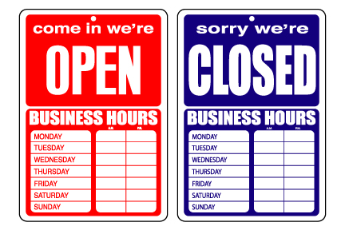
WebSocket
Event handlers
The interface provide four event handlers :
onopen
onmessage
onclose
onerror

Slide 50
WebSocket
Example
var WS_URL = "ws://www.host.com/socket"
, websocket = new WebSocket(WS_URL, "echo-protocol");
websocket.onopen = function(evt) {
websocket.send("Hello Socket!");
}
websocket.onmessage = function(evt) {
console.log("Socket says: " + evt.data);
}
websocket.onclose = function(evt) {
console.log("You are disconnected from the socket.");
}

Slide 51
Questions ?

Slide 52

Socket.io
Server Events

Slide 53
Socket.IO
What is Socket.IO ?
Socket.IO aims to make realtime apps possible in every browser and mobile device
Blur the differences between the different transport mechanisms
Notes:
https://npmjs.org/

Slide 54
Socket.IO
What is Socket.IO ?
A unique API for realtime applications using in function of the browser compatibility :
WebSocket protocol
Adobe Flash sockets
JSONP polling
AJAX long polling
Notes:
https://npmjs.org/

Slide 55
Socket.IO
Simple Example
io.sockets.on('connection', function (socket) {
socket.emit('news', { hello: 'world' });
socket.on('my other event', function (data) {
console.log(data);
});
});
NodeJS code
<script src="/socket.io/socket.io.js"></script>
<script>
var socket = io.connect('http://localhost');
socket.on('news', function (data) {
console.log(data);
socket.emit('my other event', { my: 'data' });
});
</script>
Client code
Notes:
https://npmjs.org/

Slide 56
Questions ?

Slide 57
Exercises
Socket.IO
Create a chat project
Use Socket.IO or WebSockets to achieve your goal
After choosing an username, you’ll be able to post messages
Invite another classmate to chat with your app to test it

Slide 58


